Slide 1
Bridging Physically Based Rendering and Diffusion Models with Stochastic Differential Equation
Paper introduction
Junwei Shu, Wenjie Liu, Changgu Chen, Hantang Liu, Yang Li, Changbo Wang School of Computer Science and Technology, East China Normal University
Kun Byte, School of Data Science and Engineering, East China Normal University
SIGGRAPH Asia 2025
ichi-raven
* All figures without annotation in this slide are quoted from the same paper

Slide 2
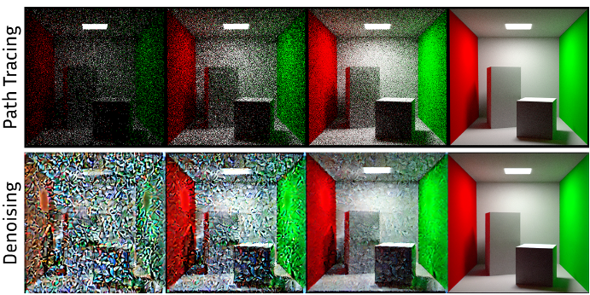
Introduction
Represent MC rendering as a time step in a diffusion model → Achieve denoising, physically plausible image generation and editing
Comparison of convergence behavior in ray tracing and denoising behavior in the diffusion model

Slide 3
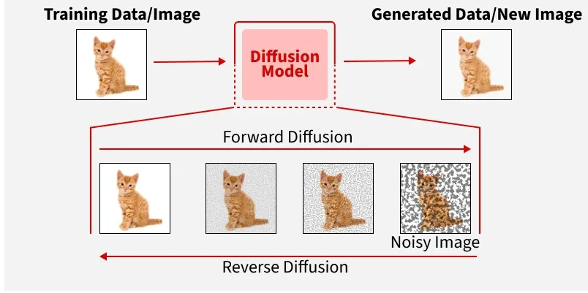
Background
Diffusion model: Generative AI model, consisting of
Forward diffusion: Add Gaussian noise to the source image and destroy it
Reverse diffusion : Denoise images covered in Gaussian noise and restore the original images
Each of these stages is called “time step”
In MC rendering as well, the results converge as time progresses (spp increases)
They unified the convergence of both sides by expressing it as a differential equation
Summary image of diffusion model (quoted from “What are Diffusion Models?”)

Slide 4
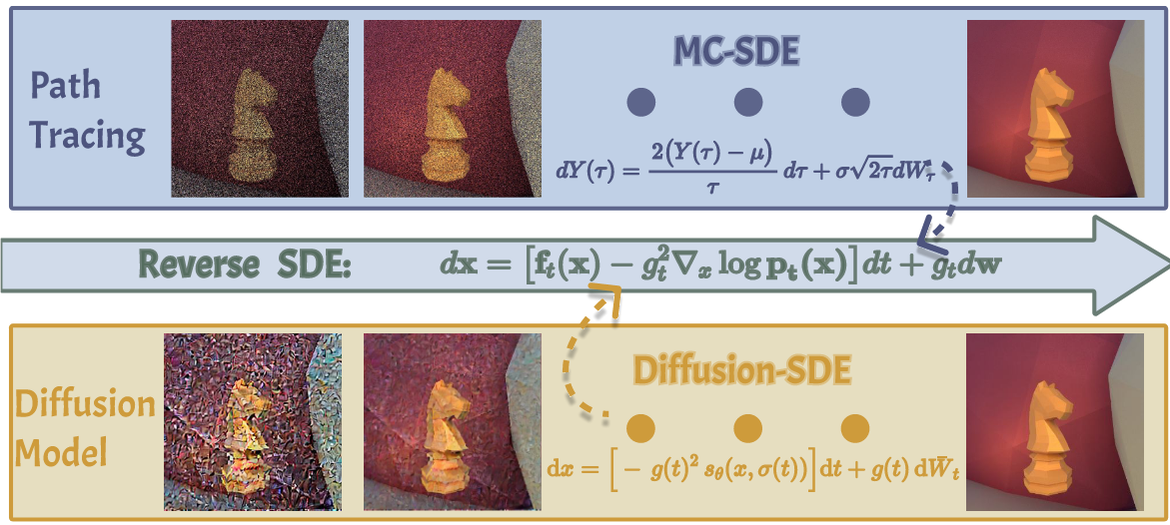
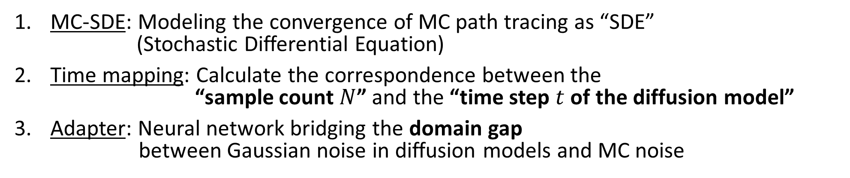
Overview
MC-SDE: Modeling the convergence of MC path tracing as “SDE” (Stochastic Differential Equation)
Time mapping: Calculate the correspondence between the “sample count $N$” and the “time step $t$ of the diffusion model”
Adapter: Neural network bridging the domain gap between Gaussian noise in diffusion models and MC noise

Slide 5
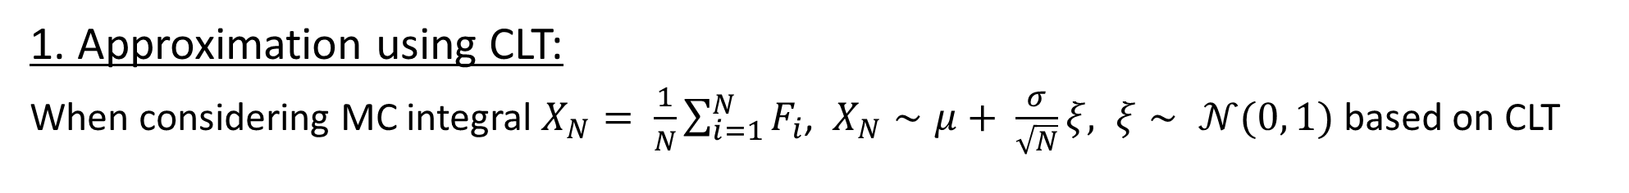
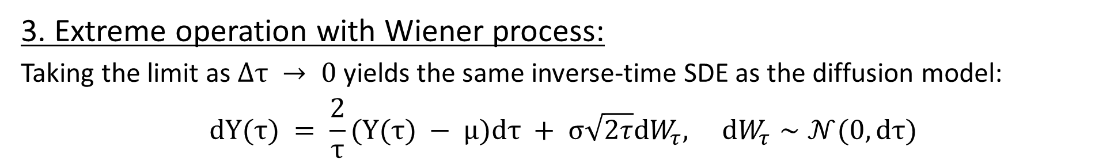
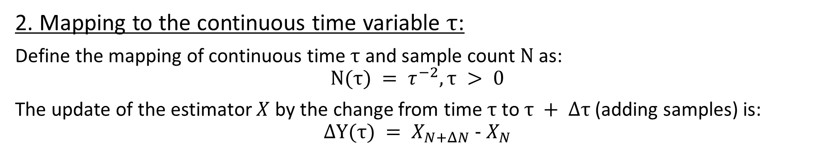
Deriving MC-SDE (roughly)
1. Approximation using CLT:
When considering MC integral $X_{N}= \frac{1}{N}\sum_{i=1}^{N}{F_{i}}$, $X_{N}∼μ+ \frac{σ}{\sqrt{N}}ξ, ξ∼ 𝒩(0, 1)$ based on CLT
2. Mapping to the continuous time variable $τ$:
Define the mapping of continuous time $τ$ and sample count $N$ as:
$$N(τ) = τ^{−2}, τ > 0$$
The update of the estimator $X$ by the change from time $τ$ to $τ + Δτ$ (adding samples) is:
$$ΔY(τ) = X_{N+ΔN} - X_{N}$$
3. Extreme operation with Wiener process:
Taking the limit as $Δτ → 0$ yields the same inverse-time SDE as the diffusion model:
$$dY(τ) = \frac{2}{τ}(Y(τ) − μ)dτ + σ\sqrt{2τ}dW_{τ}, dW_{τ}∼𝒩(0, dτ)$$
Drift term
Diffusion term (noise)

Slide 6
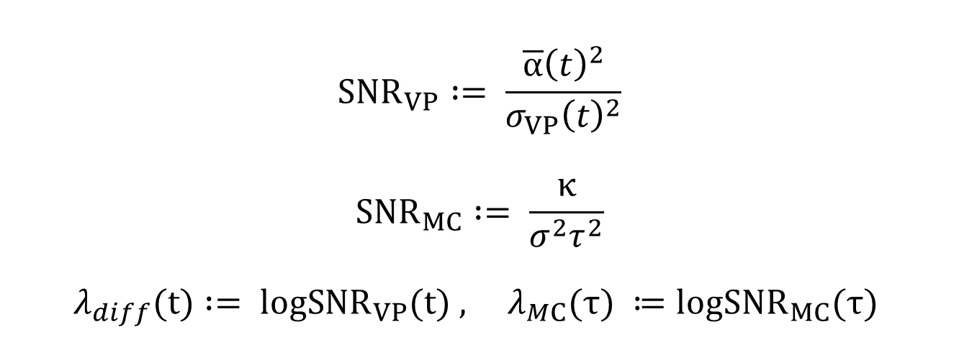
Time mapping
Estimate diffusion model’s time step $t$ s.t. the log-SNR match to the MC image at time point $τ$
$$SNR_{VP} := \frac{\overline{α}{\left(t\right)}^{2}}{σ_{VP}{\left(t\right)}^{2}}$$
$$SNR_{MC} := \frac{κ}{σ^{2}τ^{2}}$$
$$λ_{diff}(t) := logSNR_{VP}(t) , λ_{MC}(τ) ≔logSNR_{MC}(τ)$$
$\overline{α}$: “Scheduler” for DDPM diffusion models, $σ_{VP}$: noise’s standard deviation
$κ$: Scaling constant for MC rendering image
Final time mapping $t*(τ) =λ_{diff}^{−1}(-2log(τ) + (logκ - logσ^{2}))$

Slide 7
Adapter
In reality, the distribution of MC noise does not follow a Gaussian → Adjust the scale and shift of feature maps using lightweight CNNs (FiLM)
FiLM (Feature-wise Linear Modulation): applies modulation to the output of a neural network by performing a linear transformation on its features

